Slide 1
Tychos Analytics
Not for profit data source for the Big Seven (60% of world GDP)
  U.S.
  China
  Japan
  Germany
  France
  India
  U.K.
High level country and sector data aggregation and trends
“A comprehensive high level look at credit”
Focus on credit concerns— central to financial crisis, recessions, and depressions

Slide 2
Tychos Thesis
Rapid growth in private credit at the country level or sector level portends credit problems for that country or sector
Why? Rapid growth in credit signals creation of oversupply or overcapacity in a given sector. Oversupply or overcapacity is only possible through rapid debt expansion
Significant overcapacity (housing, drilling rigs) generally followed by
  Drop in sector activity and increased sector layoffs while demand catches up
  High losses for lenders in that sector
At large enough scale, this describes a national financial crisis

Slide 3
Country level examples: US in 2000s

Slide 4
Country level examples: Japan in 1980/90s

Slide 5
Country level examples: US in 1920s

Slide 6
Country level examples: US in 1920s

Slide 7
Sector level examples: US Energy in 2010s

Slide 8
Sector level examples: Student lending 2010s

Slide 9
Sector level examples: Telecommunications 2001
WorldCom collapse

Slide 10
Reports found at www.tychosgroup.org
First quarter 2020
Pre-pandemic, lag in data
Lag usually less of an issue because trends develop over multiple years
Sets us up to understand more clearly the second quarter report coming out in October

Slide 11
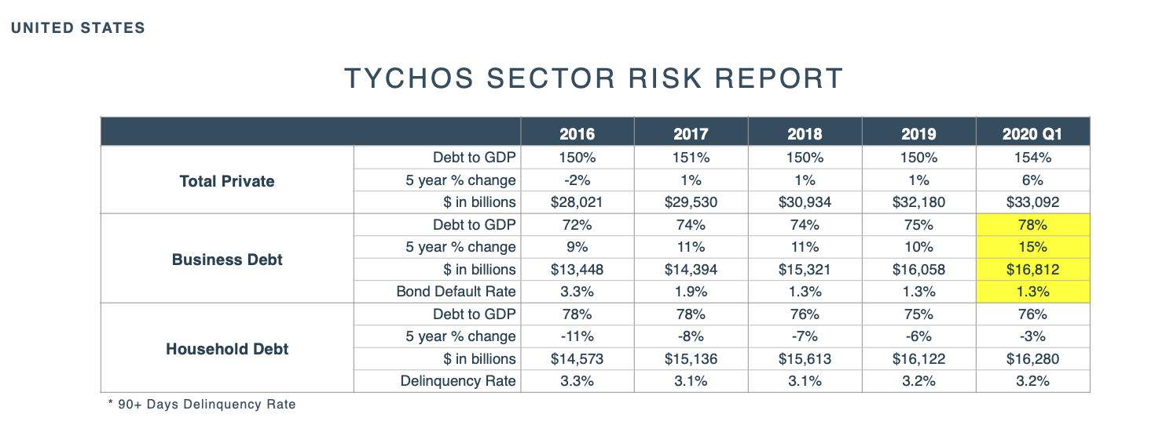

Slide 12
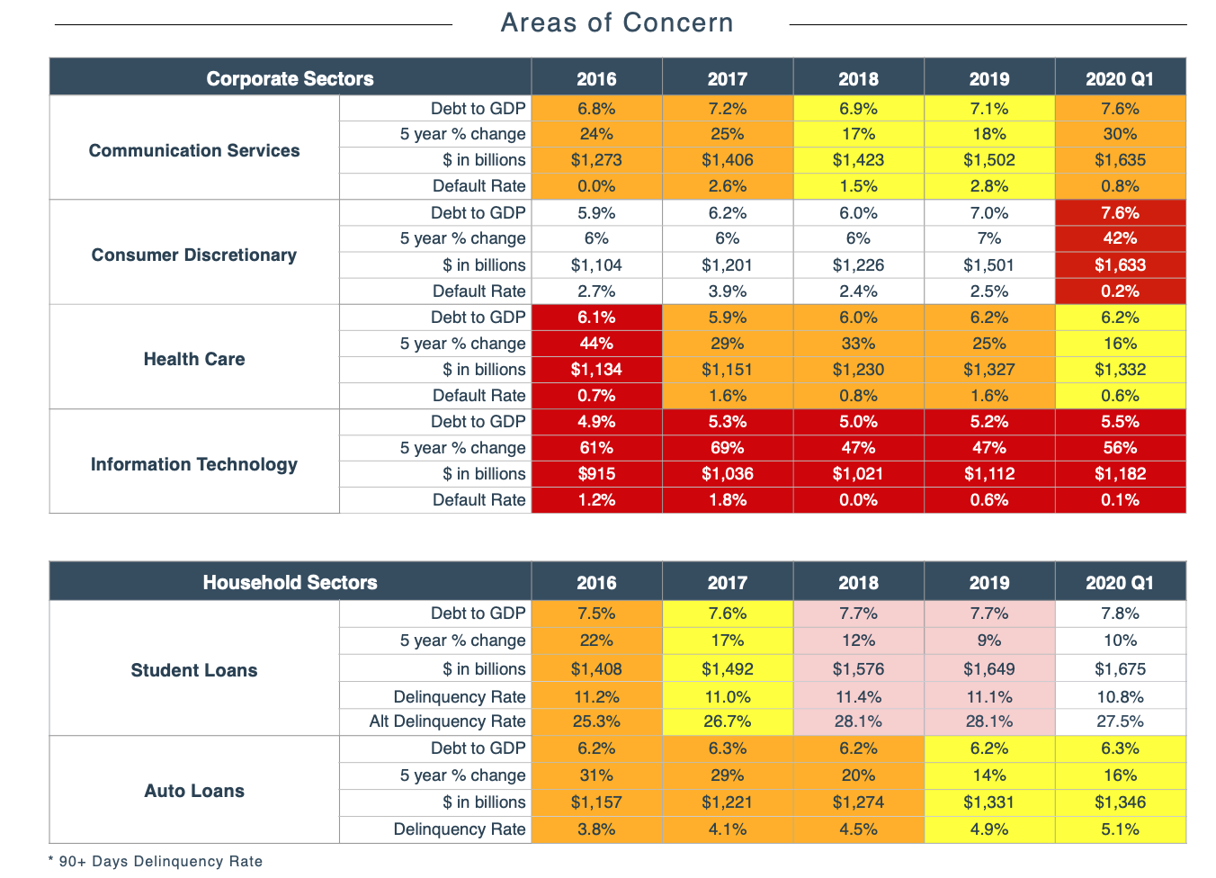
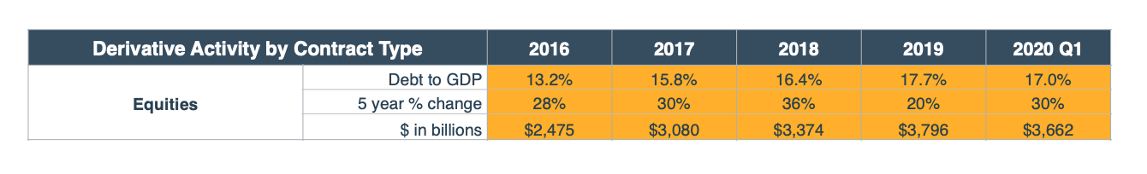
Delinquency and losses
are lagging indicators

Slide 13
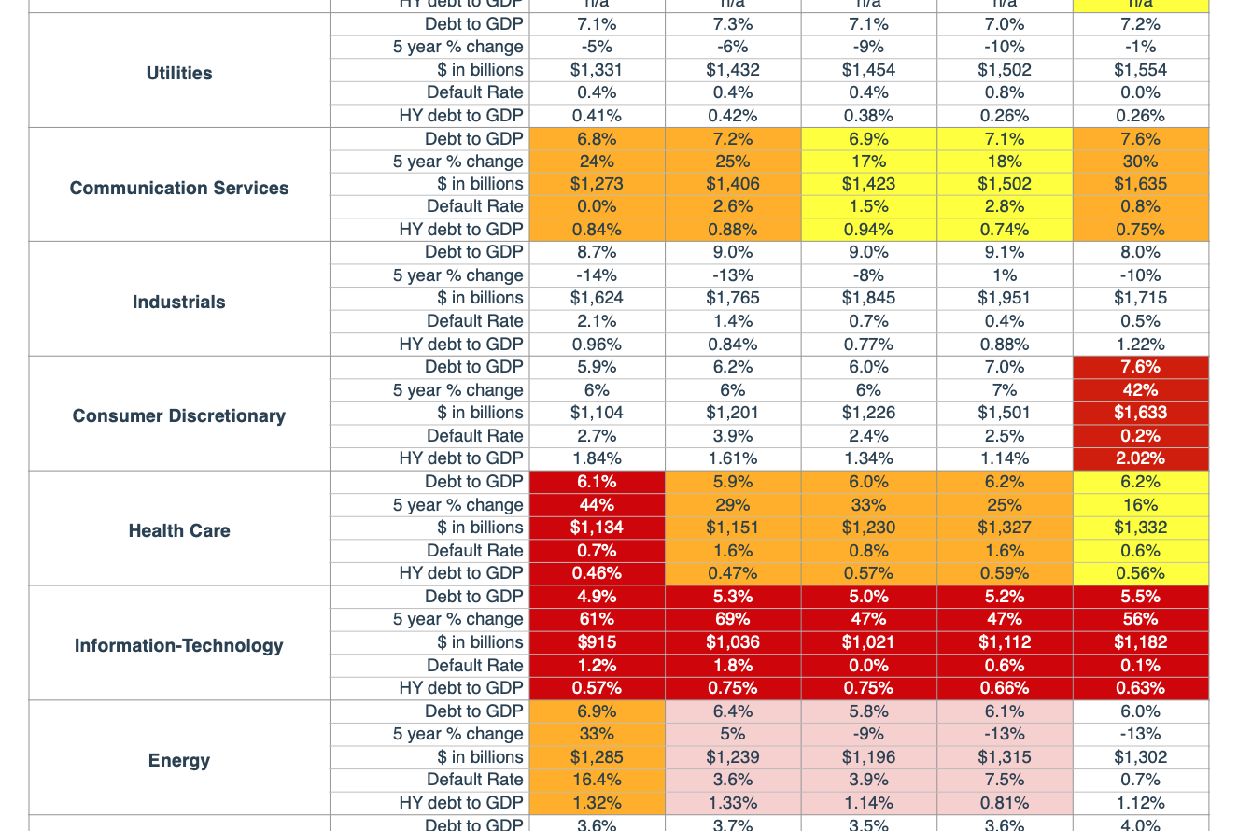

Slide 14
Guidelines
Country 20%/150%
Sector 20-40%
Not rules, only guidelines
Government actions and/or other circumstances can act to mitigate or solve a country or sector crisis
The beginning of analysis, not the end

Slide 15
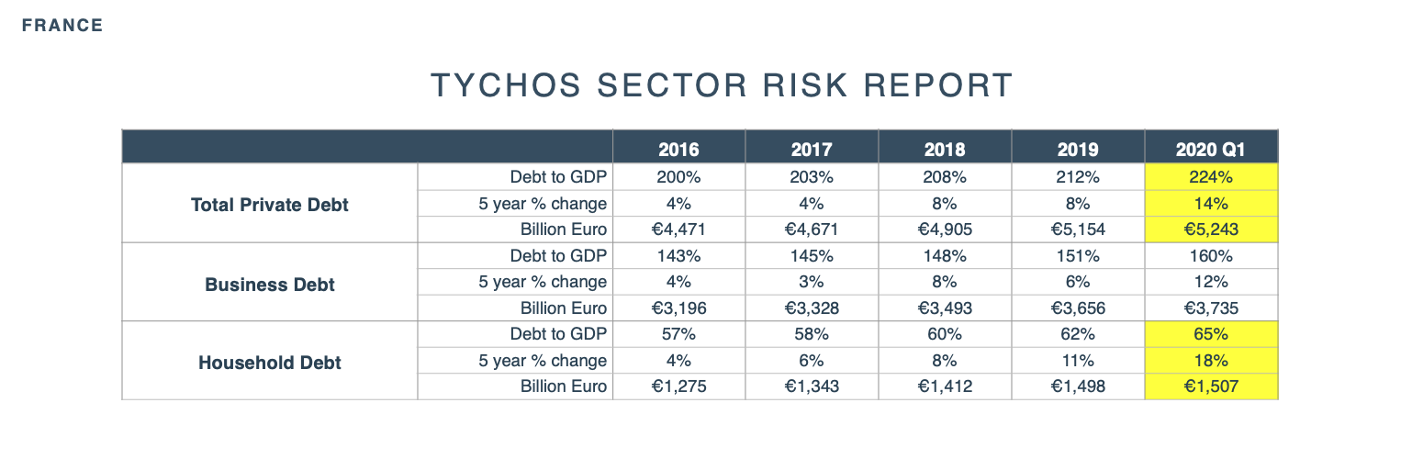
Benefit comes early, problems come later

Slide 16
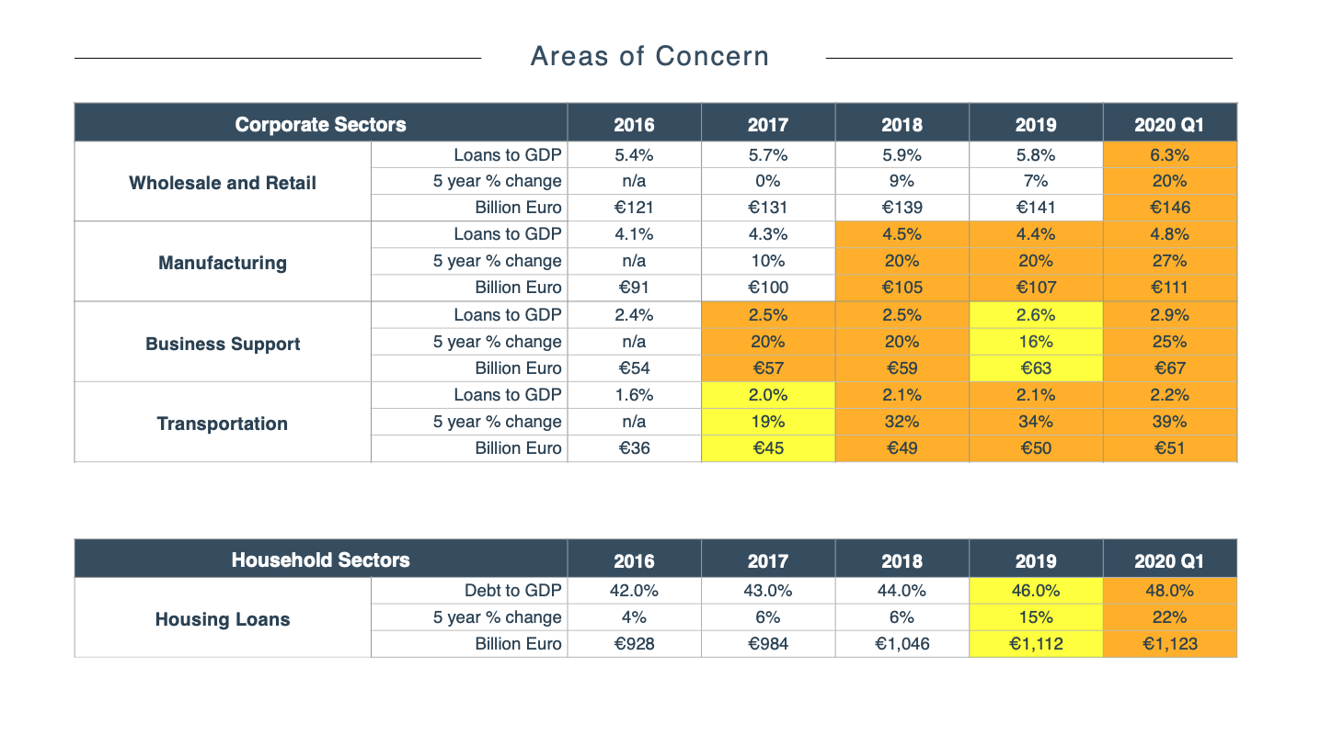

Slide 17
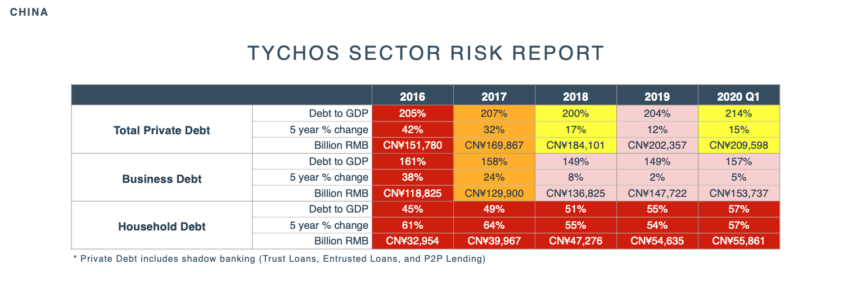
Include shadow banking
Consumer debt is catching up

Slide 18
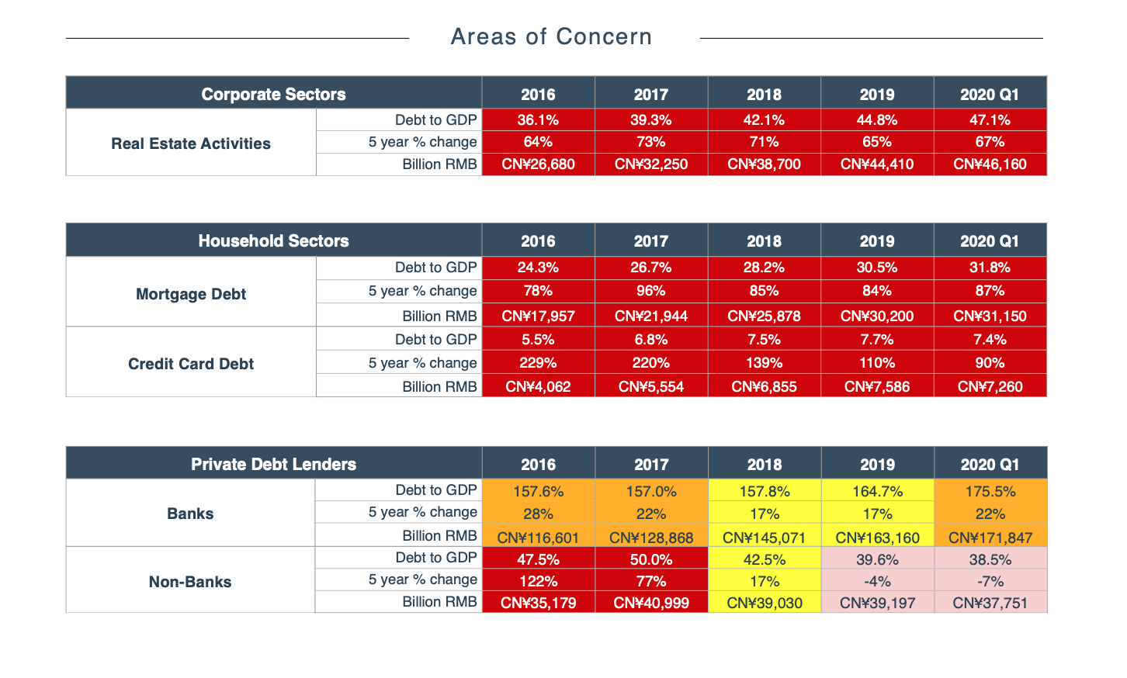

Slide 19
China is unique because it owns largest lenders and borrowers
Rescue expertise demonstrated in post-1999 crisis
China has shown a preemptive capacity to support larger banks, direct capital replenishment, and assist in bad debt disposal
Current private debt growth compensation for loss of export advantage
We expect continued GDP deceleration and exporting of deflation

Slide 20
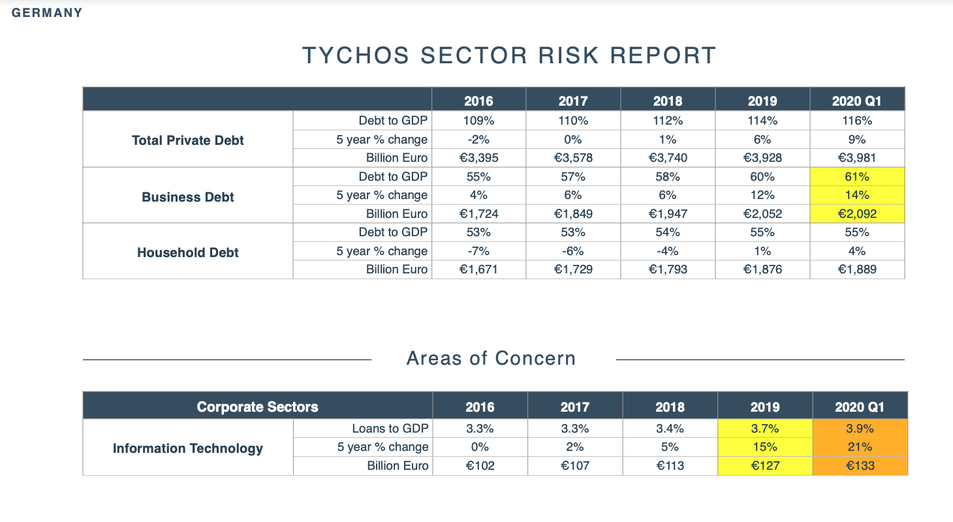

Slide 21
Areas in report
Risk by sector
Risk by institution type
Risk by security type
Cross border risk
Derivative risk
Largest lenders
Detail on mortgage and housing activity

Slide 22
Country Net Worth Report
A country’s net worth is in essence the sum of the net worth of its households, businesses (NFCs), financial institutions, and government
Value is in getting a general sense of direction of these trends—improving or declining?

Slide 23
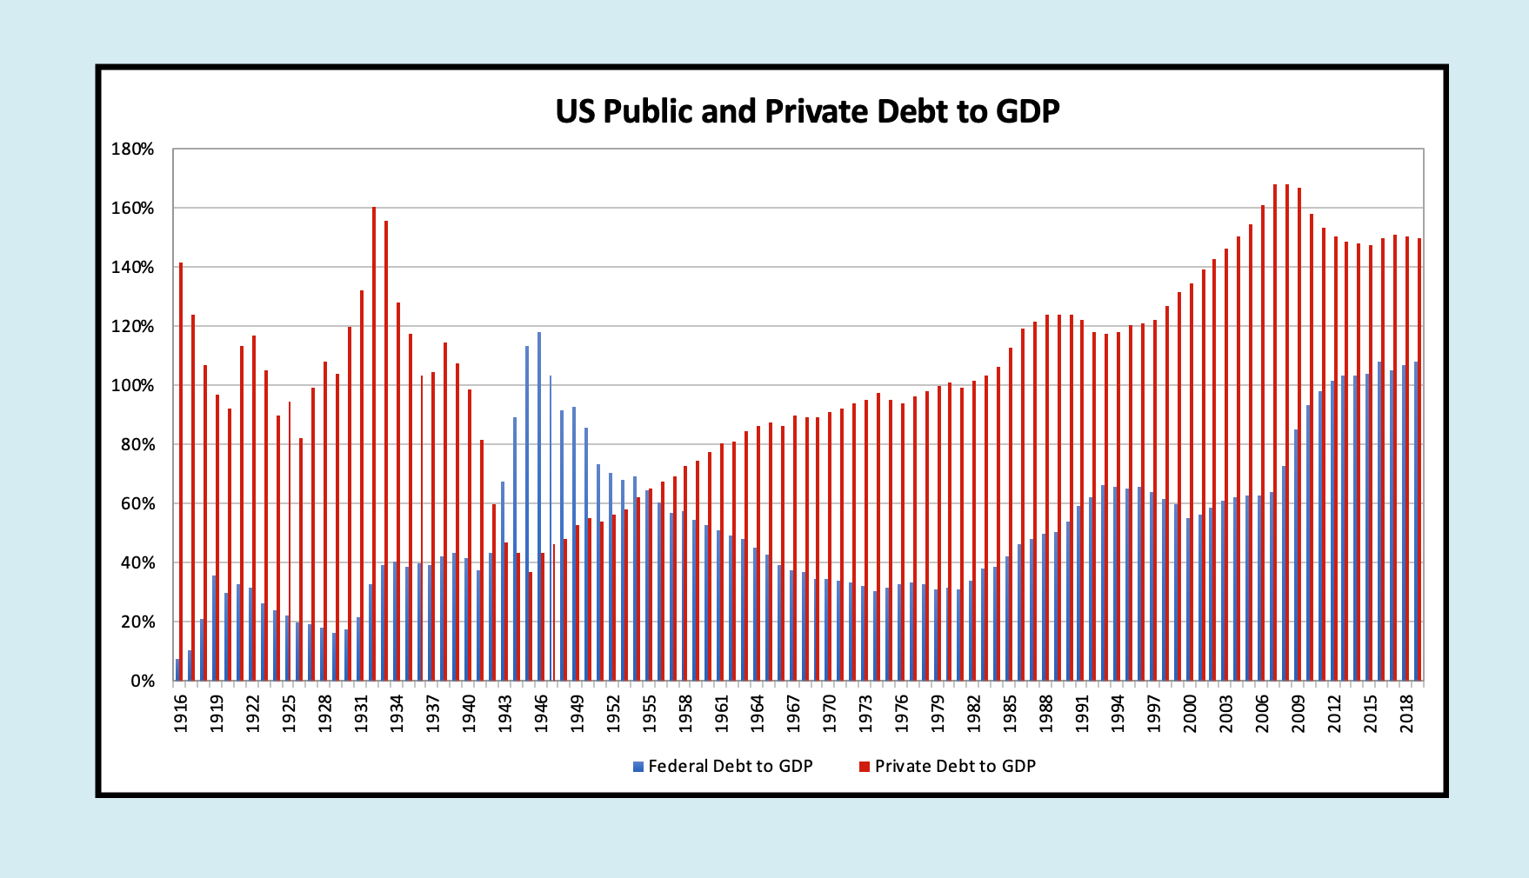

Slide 24
Incomplete Story with Only Debt
Need the asset side of the story
Assets can be misleading in the short term, e.g. 2007—but helpful picture over the long term

Slide 25
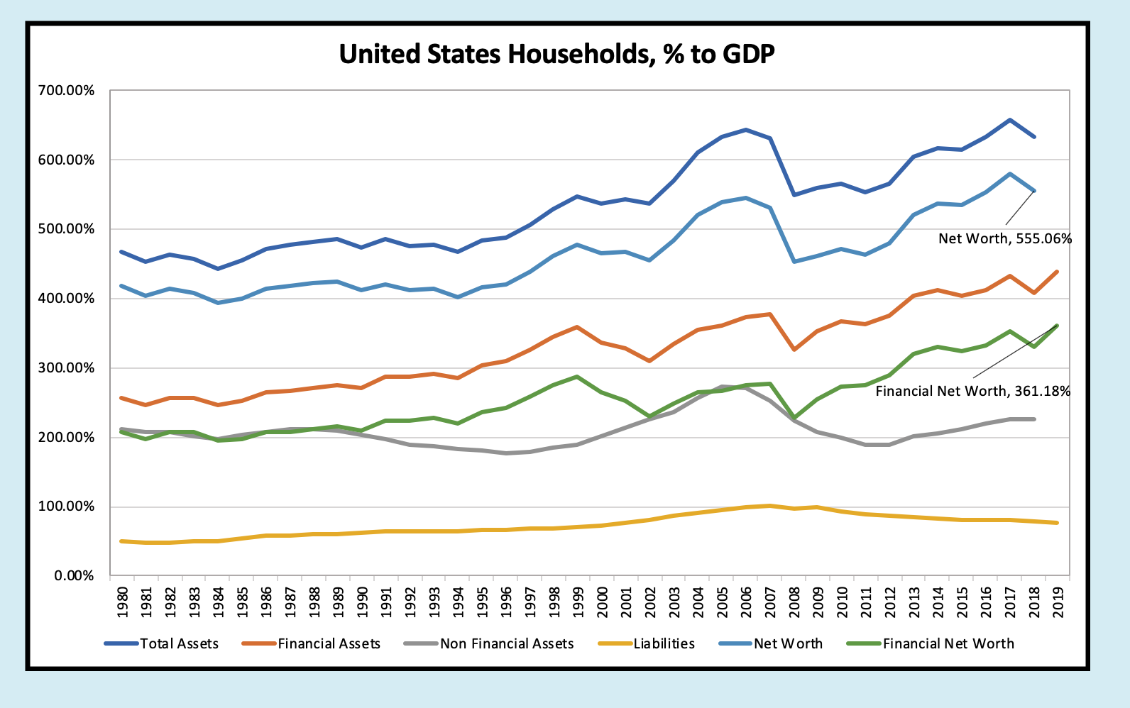

Slide 26
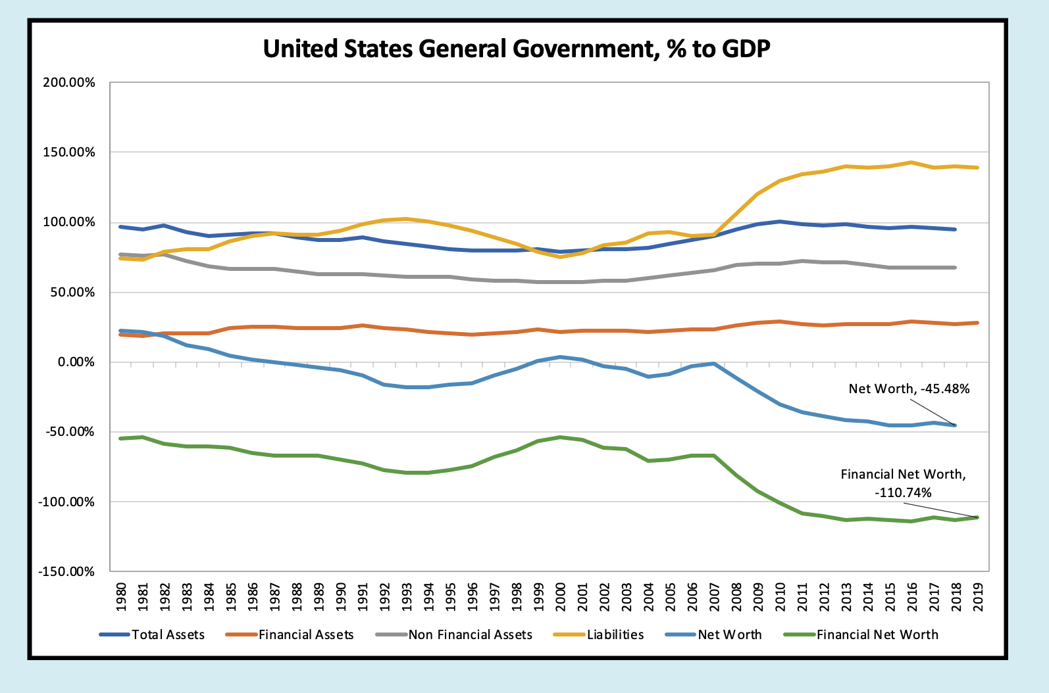
Will become
sharply more
negative

Slide 27
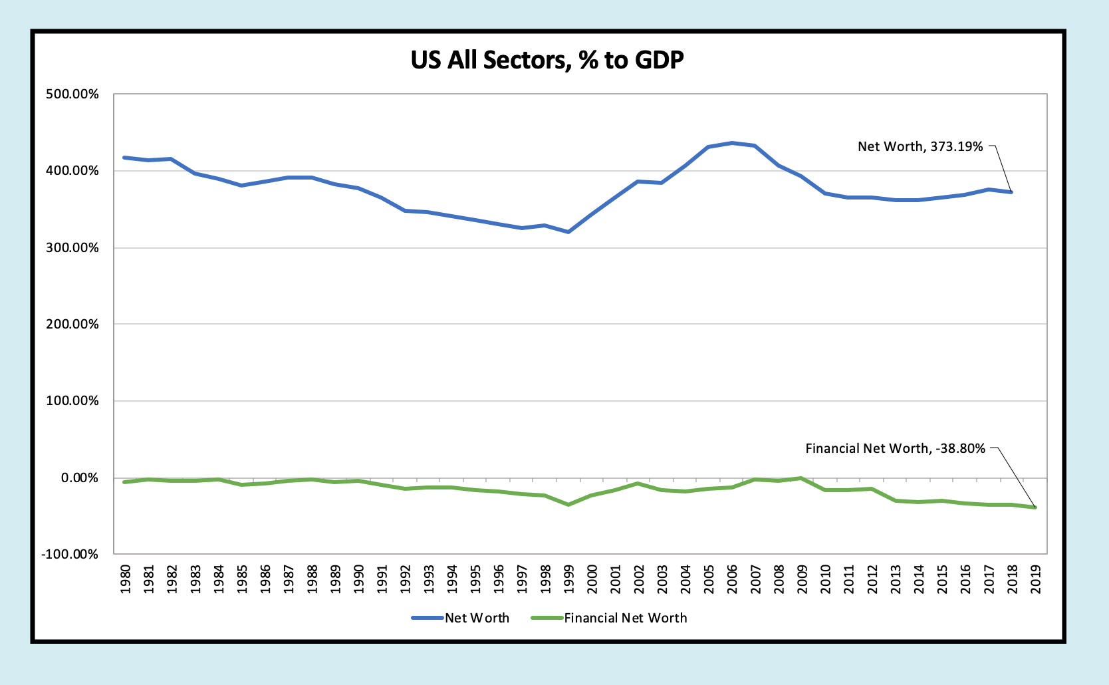

Slide 28
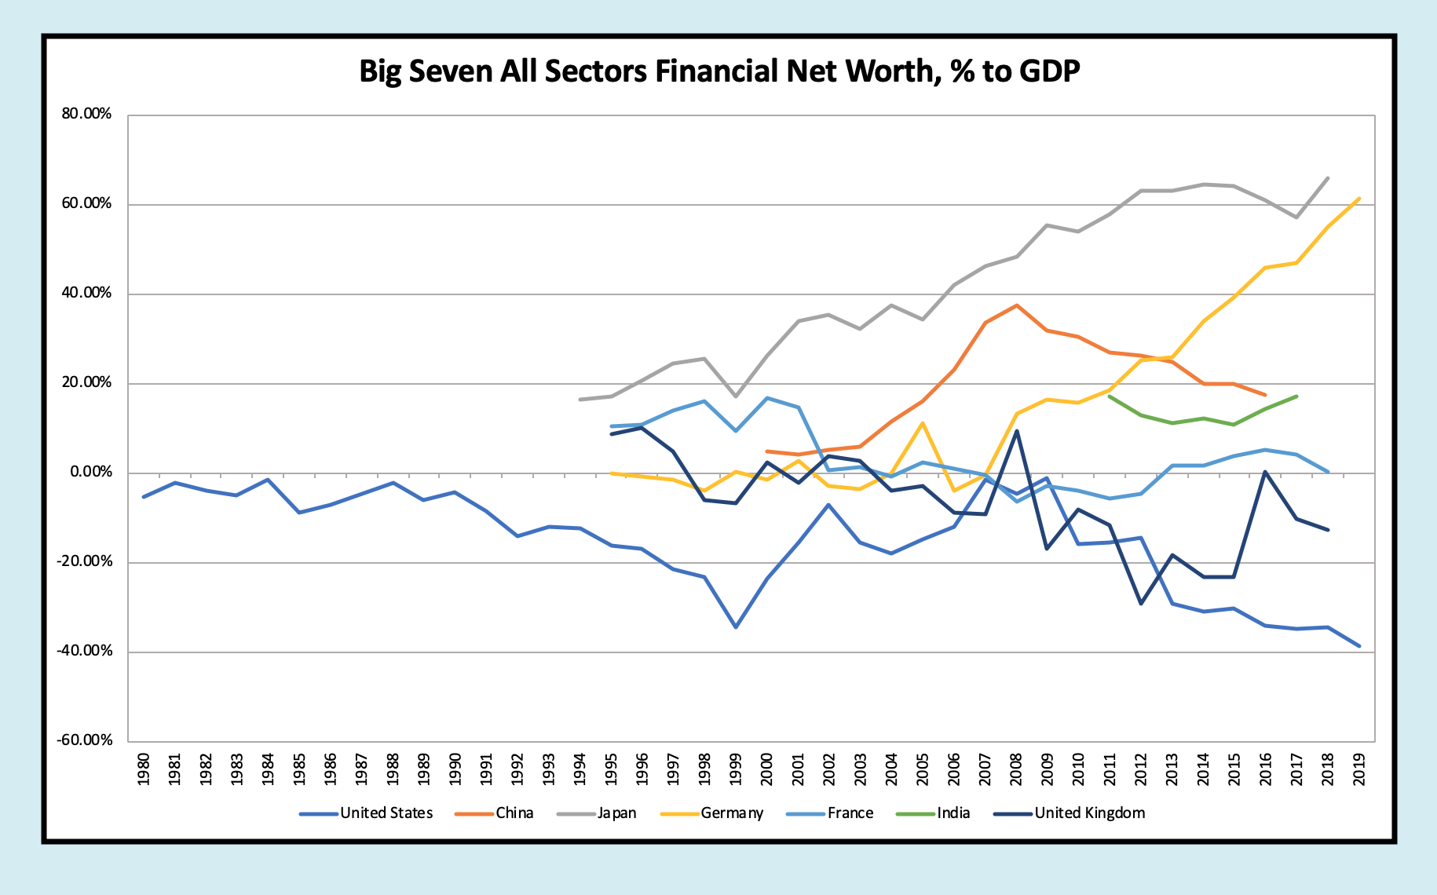
Big Seven Country Net Worth Comparison

Slide 29
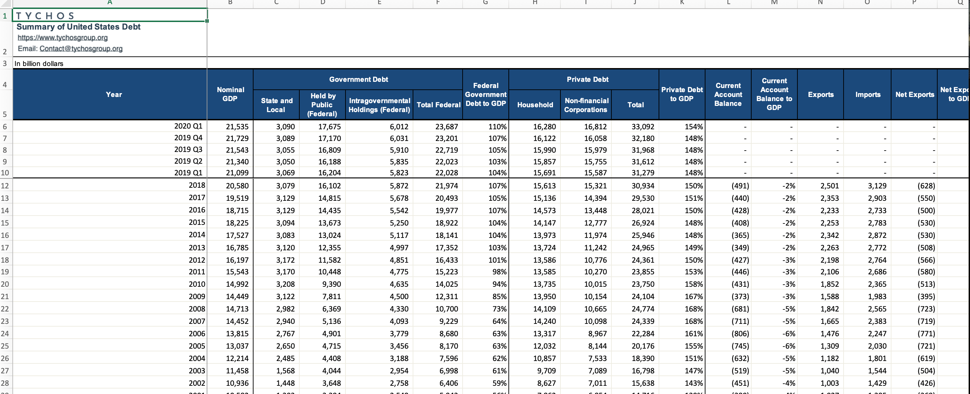
Third Report: Historical Debt, Trade, and Inflation Data

Slide 30
Thank you!
Happy to be wrong! dan@govwoods.org rvague@gmail.com

Slide 31
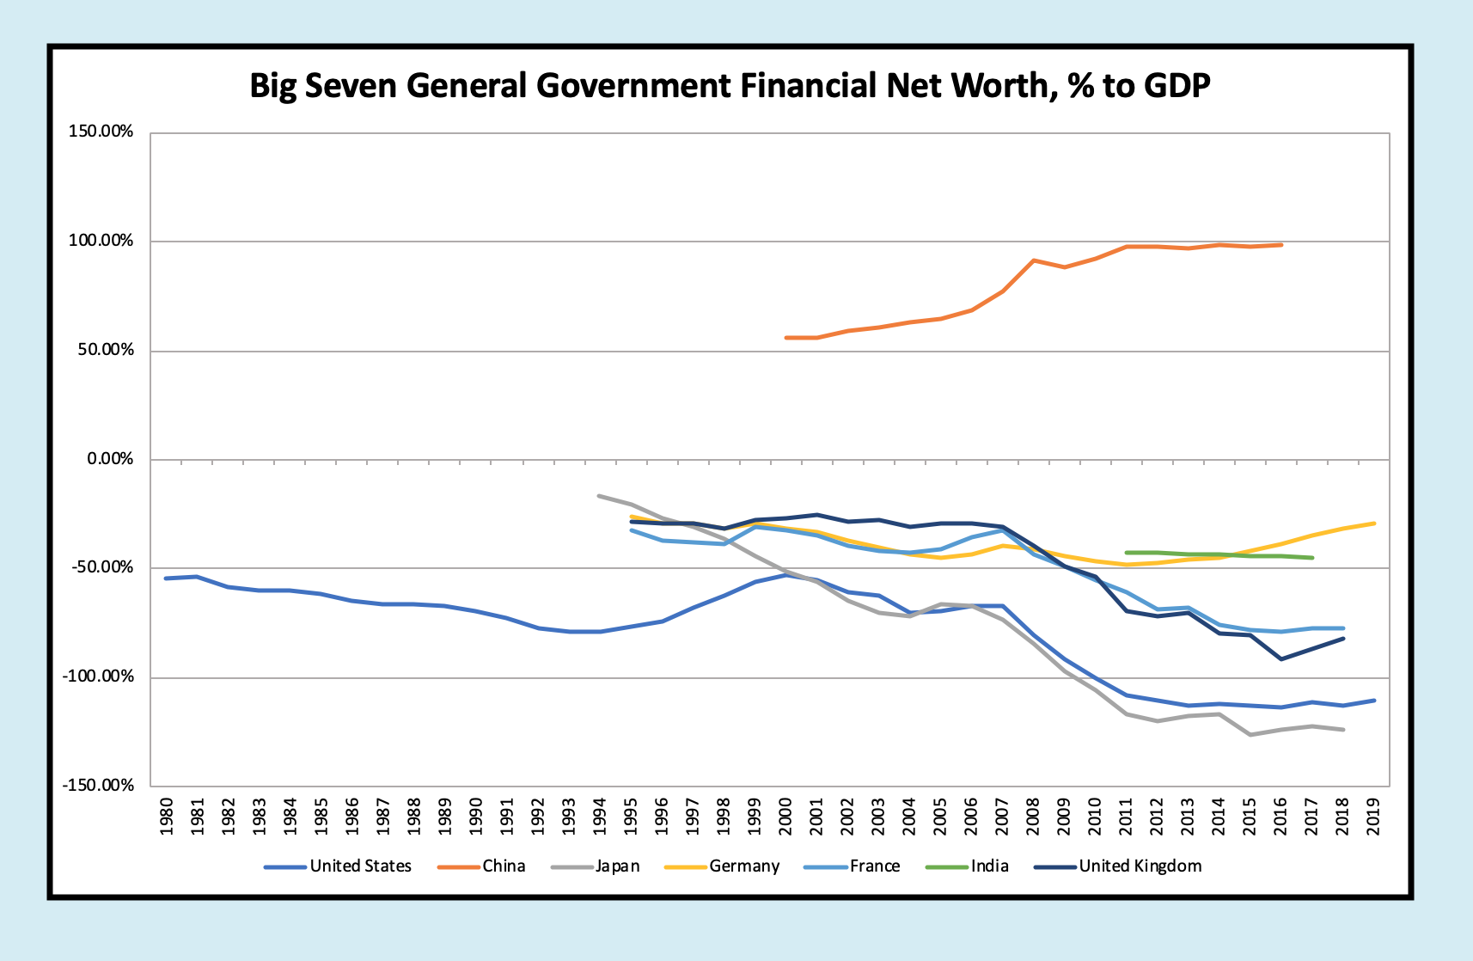

Slide 32
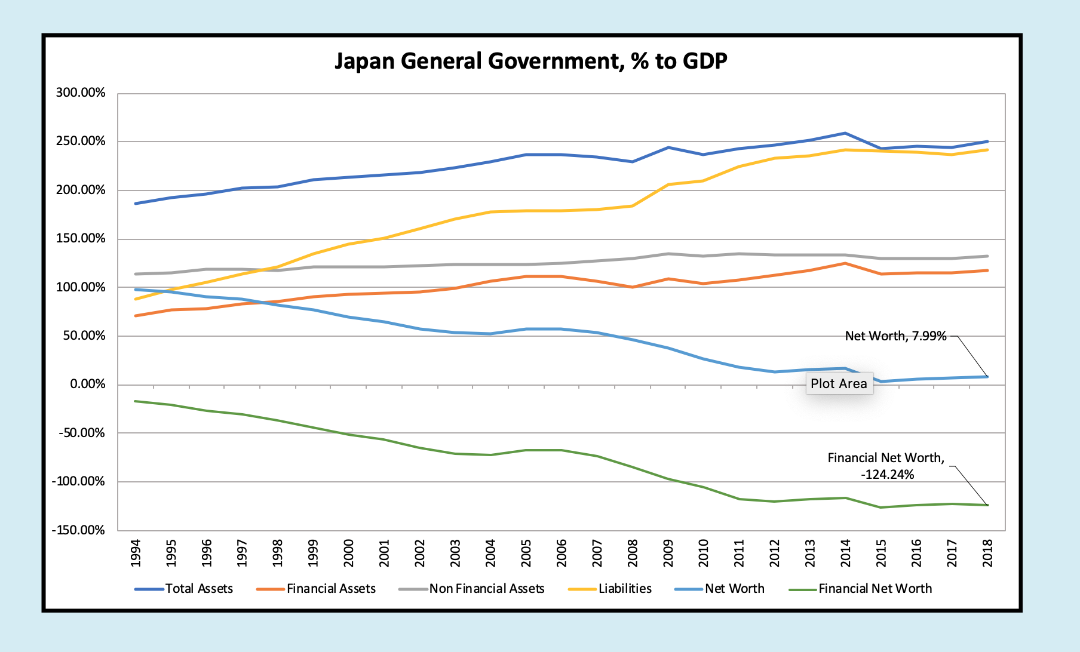

Slide 33
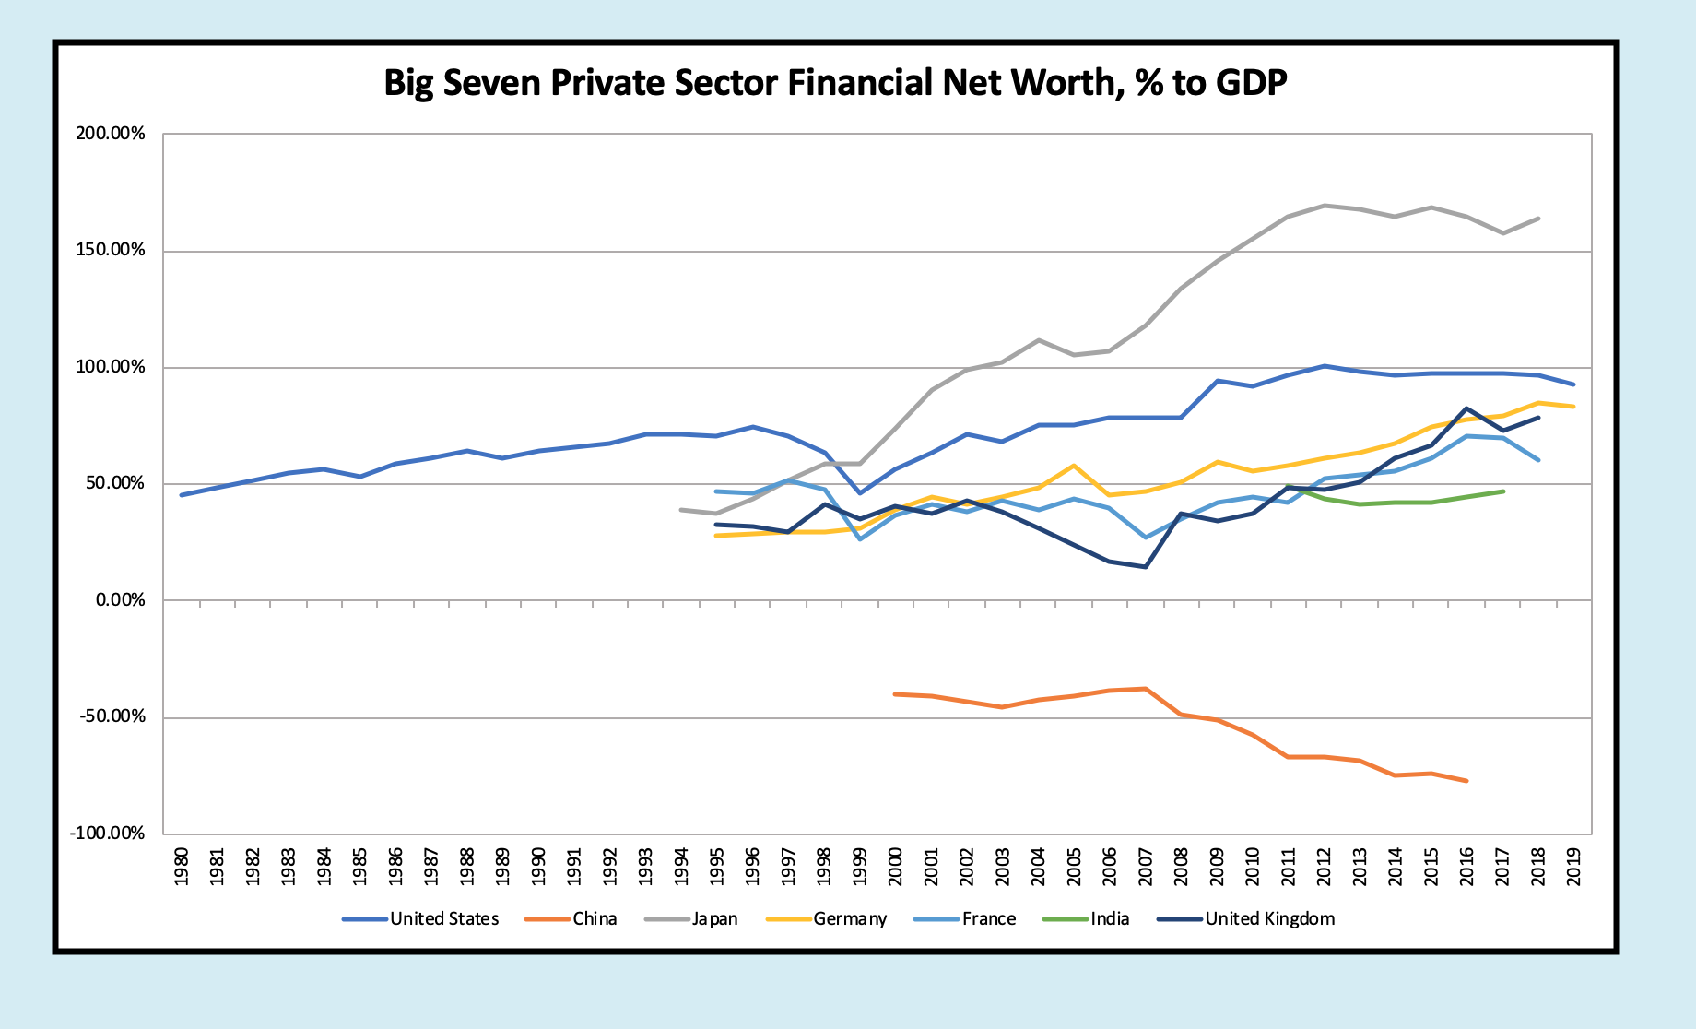
Big Country HH+NFC Net Worth Comparison

